Slide 1


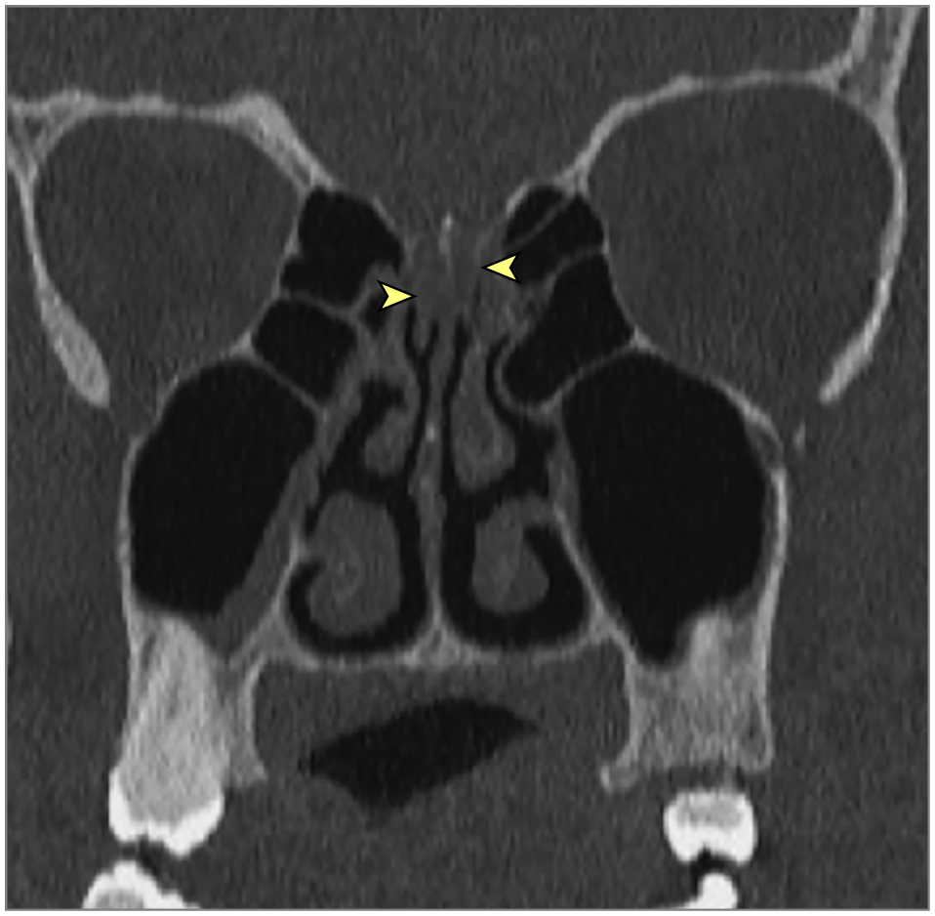
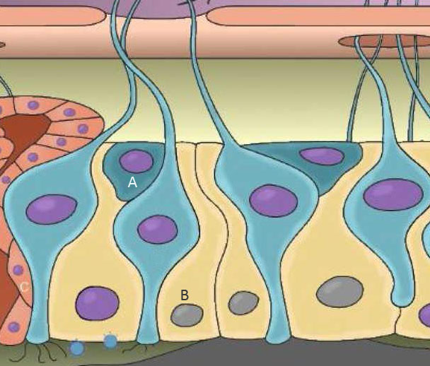
Anosmia and hyposmia in Covid-19 infection
ŽELJKO ČULINA¹, Nataša Skitarelić^{2,4}, Duje Čulina⁶, Neven Skitarelić^{3,4,5} ¹Department of pulmology, General Hospital Zadar; ²Department of pediatric, General Hospital Zadar; ³Department of otolaryngology, General Hospital Zadar; ⁴Department of Health Studies Universitiy of Zadar; ⁵School of Medicine Universitiy of Rijeka, ⁶UHC Zagreb, Clinic for lung diseases Jordanovac, Zagreb
At the end of 2019 in Wuhan, China, a novel coronavirus, Severe Acute Respiratory Syndrome Corona virus 2 (SARS-CoV-2), was considered the cause of some lower respiratory tract infections. On February 11, 2020, the new disease caused by the SARS-CoV-2 virus was officially termed “COVID 19” by WHO. Transmission from person to person occurs mainly by direct contact or droplets spread by coughing or sneezing by an infected individual with SARS-CoV-2.
The most common symptoms are fever, cough, fatigue, headache, dyspnea, and anosmia/hyposmia. In the most severe cases, patients may develop pneumonia, acute respiratory failure, distress syndrome, and acute heart problems.
The most possible mechanisms of olfactory disorders in SARS–CoV-2 infection are: suppression of the olfactory bulb with penetration of the virus (Fig 1), mucosa edema of the olfactory bulb (Fig 2), and damage of the sustentacular cells in the olfactory epithelium (Fig 3). Damage to sustentacular cells and Bowman cells directly affects the perception of odors, not by the transmission of the virus to olfactory receptor neurons but by impairing some of its functions that are necessary for the functional metabolism of these neurons. Mature olfactory neurons do not express ACE 2 receptors, and therefore are not likely to be infected by SARS-CoV-2. Damage to sustentacular cells is the most important mechanism of olfactory damage in Covid-19 infection. In most patients with olfactory disturbances after fourteen days, the epithelium showed signs of recovery.
Fig 1. MR with contrast – suppression of olfactory bulb in patients during SARS-CoV-2 infection.
Fig 2. MSCT bilateral obstruction of the olfactory cleft in a patients with SARS-CoV-2 infection - swelling of mucosa in the olfactory groove prevents odors from gaining access to the olfactory area.
Fig 3. Normal olfactory epithelium with invasion of SARS CoV-2 (A). Damage to sustentacular cells, loss of cilia from olfactory receptor neurons and interruption of mucus production (B).
12th Congress of the Croatian Thoracic Society
25-28 May 2022 Zagreb, Croatia

