Slide 1
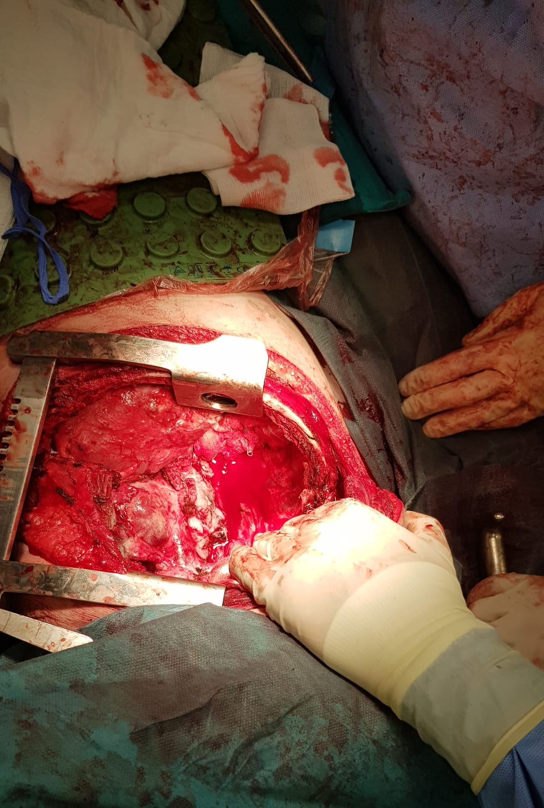
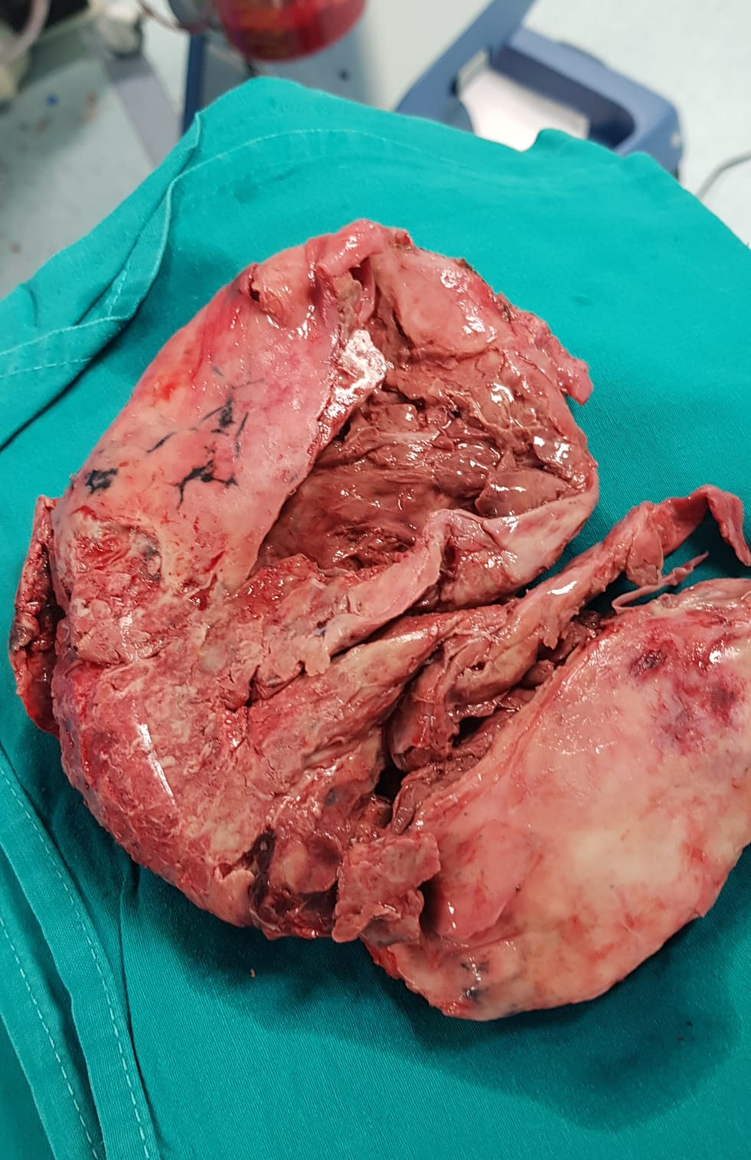
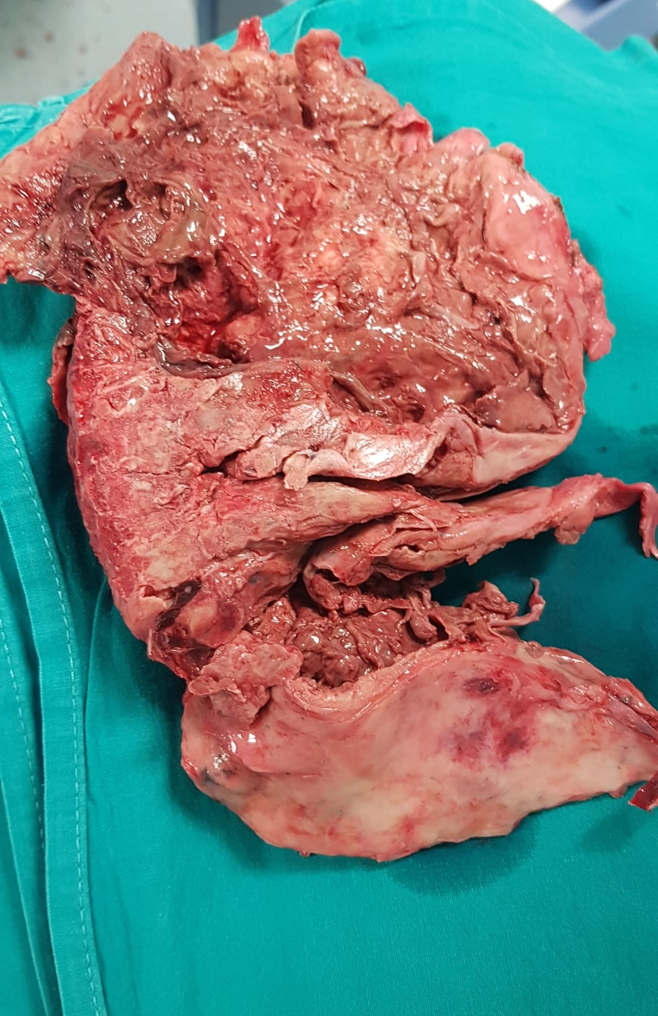
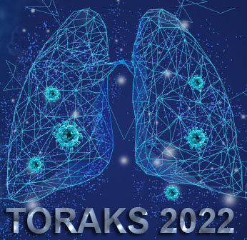
Unilateral antibody mediated rejection in a lung transplant patient: a case report
Čulina D.¹, Džubur F.¹, Glodić G.¹, Madžarac G.², Hiršl D.², Janevski Z.², Špiček Macan J.⁴, Bašić Jukić N.³, Žunec R.⁵, Samaržija M.¹
¹Clinic for lung diseases,UHC Zagreb ²Clinic for thoracic surgery,UHC Zagreb ³Clinic for internal diseases,UHC Zagreb ⁴Clinic for anesthesiology, reanimatology and intensive care,UHC Zagreb ⁵ Department for tissue typization, UHC Zagreb
Introduction:
Lung transplantation is the therapeutic measure of last resort for patients with end-stage lung disease who have exhausted all other treatment options. Lung transplant rejection occurs when the transplanted lungs are recognized and destroyed by the recipient's immune system. Transplant rejection can be hyperacute, acute, or chronic with several different phenotypes of both acute and chronic rejection. Herein, we present a case of a 31-year-old female patient who underwent bilateral lung transplantation for cystic fibrosis and eventually died of complications of unilateral antibody-mediated lung transplant rejection
Case report:
Initial bilateral lung transplantation was performed at the age of 28, but almost immediately after the surgical procedure, extensive reperfusion edema developed in the right lung. Consequently, two days later explantation and unilateral retransplantation were successfully performed. After recovery, the patient was stable during the first two years of follow-up on standard immunosuppressive therapy. Almost two years post-transplant chronic unilateral rejection of the re-transplanted right lung induced by antibodies was verified. Immunogenetic typization detected donor antibodies of HLA class II DQ3 specificity with an initial titer of around 600-1600 with a later increase up to MFI 4000. MSCT of the thorax showed ground-glass lesions alongside reticular changes and multiple peripheral consolidations in the right lung parenchyma. The patient was treated with 33 cycles of immunoadsorption therapy alongside intravenous immunoglobulins and corticosteroids. Despite optimal therapy, the disease progressed and the percentage of right lung involvement in total lung function was approximately 5%. The diseased graft became a source of recurrent infections and sepsis. After extensive discussion with the surgical team, it was decided to proceed with pneumonectomy, instead of a second retransplantation, due to the inability to successfully implant the new lung. Finally, the patient died of perioperative cardiac and hemorrhagic shock due to atrial wall rupture alongside previously developed sepsis.
Fig 1. Pericard patch of ruptured atria
Conclusion:
To our knowledge, this is the only case of unilateral antibody-mediated rejection (AMR) in a lung transplant recipient. Despite intensive treatment with immunoadsorption and augmented immunosuppression, the disease progressed, eventually destroying the right lung and requiring pneumonectomy.
Fig.2 and 3. Explanted rejected right transplant lung showing destroyed lung tissue alongside huge cavernas
12th Congress of the Croatian Thoracic Society
25-28 May 2022 Zagreb, Croatia

