Slide 1
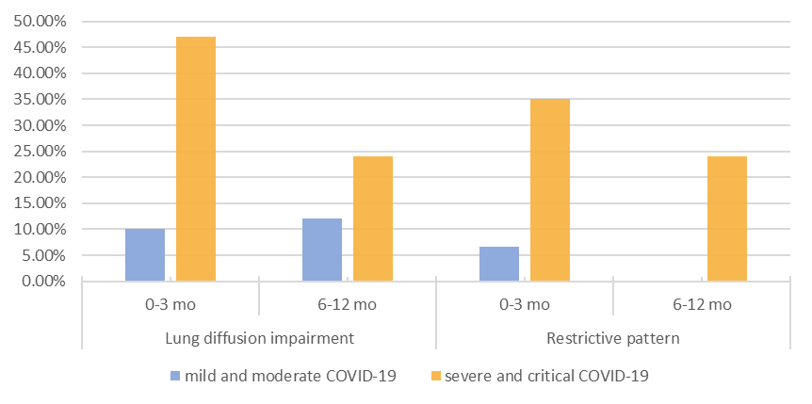
Prevalence of pulmonary function disorders in the first 12 months after acute COVID-19 disease
TOLIĆ E.¹, Basara L.¹, Janković Makek M.¹٫² , Hećimović A.¹, Butorac-Petanjek B.¹, Jalušić Glunčić T.¹, Muršić D.¹, Boras Z.¹, Darapi D.¹, Radić V.², Doder F.², Vukić Dugac A. ¹٫² , Pavliša G.¹٫², Samaržija M.¹٫²
¹University Hospital Center Zagreb, Clinic for Respiratory Diseases Jordanovac, ²University of Zagreb, School of Medicine
AIM
While most patients with acute COVID-19 infection experience full recovery, a number of patients with COVID-19 pneumonia experience long-term lung function disorders. In this study, we aimed to evaluate pulmonary function tests of COVID-19 survivors.
METHODS
The study included 125 COVID-19 survivors without previous chronic lung disease, who were referred to the Clinic for Respiratory Diseases Jordanovac in the period between November 2020 and April 2021. We categorized them into two groups according to the Croatian Institute of Public Health's criteria: mild/moderate and severe/critical acute COVID-19 disease. Each group was then divided into two subgroups – patients examined in the first three months (early recovery phase), and those examined in the period after six months following acute illness (late recovery phase). We analyzed the results of spirometry and the diffusing capacity of the lungs (DLCO).
Chart 1.: Prevalence of DLCO impairment and restrictive pattern in the early and late recovery phase
RESULTS
CONCLUSION
There were 62 patients in the mild/moderate group, of which 30 were examined in the early phase, and 32 in the late phase of recovery. Out of 63 patients in the severe/critical group, 34 and 29 were evaluated in the early and late phase of recovery, respectively. Distribution according to sex and age was similar in all subgroups, with male predominance (72.5%) and a mean age of 56.3 ±11 years. In the early phase, 10% of patients with non-severe and 47% of patients with severe COVID-19 demonstrated pulmonary diffusion impairment (DLCO <75% of the predicted value), while 6.67% and 35% of patients, respectively, showed a restrictive pattern in spirometry. In the late phase recovery group, DLCO impairment was apparent in 12.12% and 24% of patients in the mild/moderate and severe/critical group, respectively. A restrictive pattern was present in 24% of patients within the severe COVID-19 group in the late phase of recovery and, interestingly, in none of the patients within the non-severe COVID-19 group. The obstructive pattern was observed only among the patients with severe disease, with a prevalence of 2.94% and 3.4% in the early phase and late phase recovery group, respectively.
Impairment of DLCO was the most frequently observed pulmonary function impairment in all subgroups. This was followed by a restrictive pattern, more prevalent in the severe/critical group and early phase of recovery, while an obstructive pattern was observed only in the severe/critical group of COVID-19 survivors. A significant proportion of functional sequelae are still present six to twelve months following COVID-19 infection in patients following severe or critical acute COVID-19.
REFERENCES
Hrvatski zavod za javno zdravstvo. Smjernice za liječenje oboljelih od koronavirusne bolesti 2019 (COVID-19) verzija 5 od 08. veljače 2022. [Internet] Zagreb: Hrvatski zavod za javno zdravstvo; 2022 [23.04.2022.]. Available at: Smjernice-za-liječenje-oboljelih-od-koronavirusne-bolesti-2019-COVID-19-verzija-5-od-08-veljače-2022..pdf (hzjz.hr)
Iversen KK, Afzal S, Ahlström MG, et al. Lung Function Decline in Relation to COVID-19 in the General Population: A Matched Cohort Study With Prepandemic Assessment of Lung Function. J Infect Dis. 2022;225(8):1308-1316. doi:10.1093/infdis/jiab636
Lewis KL, Helgeson SA, Tatari MM, Mallea JM, Baig HZ, Patel NM. COVID-19 and the effects on pulmonary function following infection: A retrospective analysis. EClinicalMedicine. 2021;39:101079. doi:10.1016/j.eclinm.2021.101079
Long Q, Li J, Hu X, Bai Y, Zheng Y, Gao Z. Follow-Ups on Persistent Symptoms and Pulmonary Function Among Post-Acute COVID-19 Patients: A Systematic Review and Meta-Analysis. Front Med (Lausanne). 2021;8:702635. Published 2021 Sep 3. doi:10.3389/fmed.2021.702635
Modi P, Kulkarni S, Nair G, Kapur R, Chaudhary S, Langade D, Uppe A. Lung function indices in patients undergoing post-COVID assessment- An observational study. European Respiratory Journal. 2021;58(65):605. doi: 10.1183/13993003.congress-2021.PA605
Torres-Castro R, Vasconcello-Castillo L, Alsina-Restoy X, et al. Respiratory function in patients post-infection by COVID-19: a systematic review and meta-analysis. Pulmonology. 2021;27(4):328-337. doi:10.1016/j.pulmoe.2020.10.013

