Slide 1
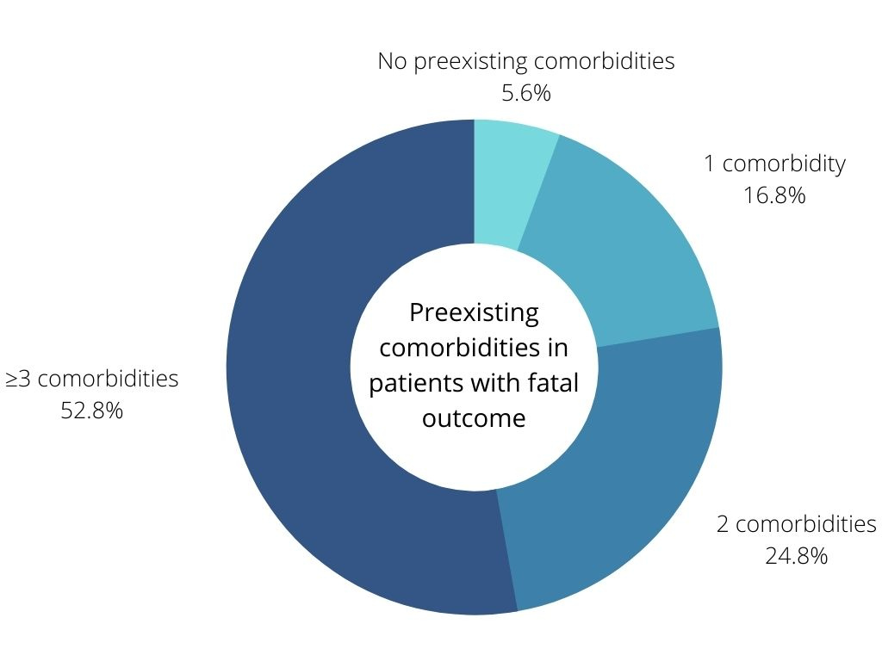
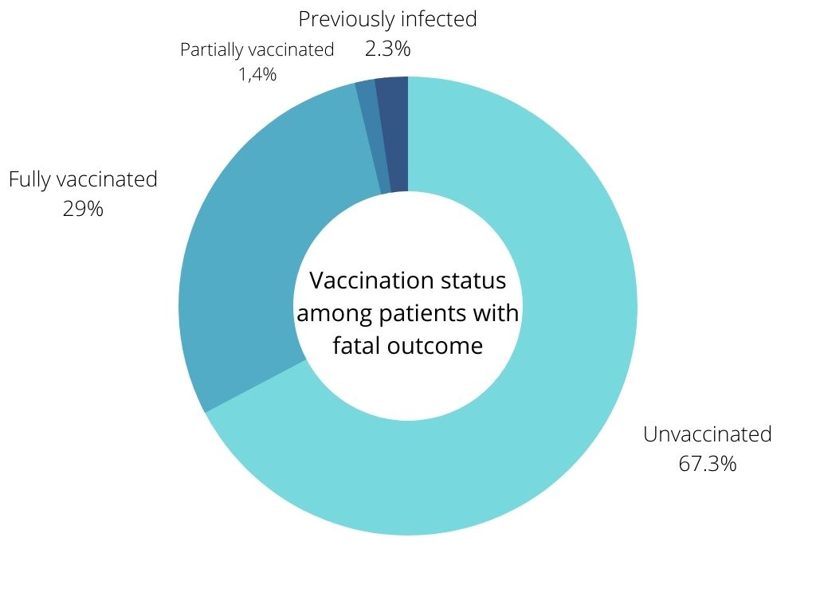
COVID-19 RELATED MORTALITY IN CLINIC FOR RESPIRATORY DISEASES “JORDANOVAC”, UNIVERSITY HOSPITAL CENTRE ZAGREB DARAPI D.¹, Samaržija M.^{1, 2}, Pavliša G.^{1, 2}, Popović F.¹, Baričević D.¹, Pevec B.¹, Tolić E.¹, Radić V.², Doder F.², Batarilo M.¹, Muršić D.¹, Štajduhar A.¹, Vukić Dugac A.^{2, 1} ¹ University Hospital Centre Zagreb - Clinic for Respiratory Diseases “Jordanovac” ² University of Zagreb - School of Medicine
Since the beginning of the COVID-19 pandemic there were more than 15.000 COVID-related deaths in Croatia. Multiple risk factors for severe COVID-19 were recognized in the literature so far, such as elderly age and preexisting chronic diseases. Reported in-hospital mortality of patients with COVID-19 varies greatly in published literature but is concerningly high in most studies. Fortunately, from December 2020 we have safe and effective vaccines available as the most powerful tool for preventing further COVID-19 fatalities. So far, 55% of the Croatian population has been vaccinated. The aim of this study was to determine in-hospital mortality of COVID-19 patients hospitalized in the Clinic for Respiratory Diseases “Jordanovac” as well as to investigate epidemiological and clinical characteristics of patients with lethal outcome.
We retrospectively analyzed data from 772 patients admitted to the COVID-19 wards of the Clinic for Respiratory Diseases from October 2021 to March 2022. 715 patients were hospitalized in regular hospital wards and 57 patients in an intensive care unit. We examined patients’ medical records and divided their preexisting comorbidities into 11 categories: cardiovascular disease, COPD, asthma, ILD, hypertension, malignancy, obesity, diabetes, cerebrovascular disease, chronic kidney disease, and immunosuppressive state.
Among patients hospitalized in regular hospital wards, 188 patients had a lethal outcome, which equates to a mortality of 26,3%. Patients hospitalized in an intensive care unit had a much higher mortality rate – 45,6% (26 out of 57 patients died). We further analyzed data from patients with fatal outcome. They were aged 32 to 99 (M=78,1, SD=10,9) with male and female patients equally represented (F=107, M=107). 12(5,6%) patients had no preexisting comorbidities, 36(16,8%) had only 1 preexisting chronic disease, 53(24,8%) had 2 chronic illnesses and 113(52,8%) had 3 or more comorbidities. The most common comorbidity was hypertension with 156 patients affected (72,9%). 144(67,3%) patients were unvaccinat
The in-hospital mortality of patients who were hospitalized with COVID-19 infection in the Clinic for Respiratory Diseases is high and comparable to results from internationally published data. The majority of patients with a fatal outcome were elderly with preexisting comorbidities and unvaccinated which is expected considering already published data about risk factors for severe COVID-19 and studies concerning vaccine effectiveness. Further analysis of this data is necessary to determine statistically significant risk factors for severe and lethal COVID-19 infection in our patient population.
AIM
RESULTS
METHODS
CONCLUSION
CHART 1.: Mortality rate among COVID-19 patients in regular wards (26,3%) and ICU (45,6%)
CHART 2.: Proportion of patients with lethal COVID-19 who had preexisting comorbidities
CHART 3.: Vaccination status among patients with fatal outcome
REFERENCES:
1. Gao Y dong,Ding M, Dong X,Zhang J jin,Kursat Azkur A,Azkur D, et al.Risk factors for severe and critically ill COVID-19 patients:A review.Allergy [Internet]. 2021 Feb 1 [cited 2022 May 3];76(2):428–55. Available from:https://onlinelibrary.wiley.com/doi/full/10.1111/all.14657
2. Roth GA,Emmons-Bell S,Alger HM,Bradley SM,Das SR,De Lemos JA, et al.Trends in Patient Characteristics and COVID-19 In-Hospital Mortality in the United States During the COVID-19 Pandemic.JAMA Netw Open [Internet].2021 May 3 [cited 2022 May 3];4(5):e218828–e218828.Available from:https://jamanetwork.com/journals/jamanetworkopen/fullarticle/2779415
3. Vena A,Giacobbe DR,Di Biagio A,Mikulska M,Taramasso L,De Maria A, et al.Clinical characteristics, management and in-hospital mortality of patients with coronavirus disease 2019 in Genoa,Italy.Clin Microbiol Infect. 2020 Nov 1;26(11):1537–44.
4.Hrvatski zavod za javno zdravstvo, 2022, accessed 2 May 2022, <https://www.hzjz.hr>
5. Tregoning JS,Flight KE,Higham SL,Wang Z,Pierce BF.Progress of the COVID-19 vaccine effort:viruses, vaccines and variants versus efficacy, effectiveness and escape. Nat Rev Immunol [Internet]. 2021 Oct 1 [cited 2022 May 3];21(10):626–36.Available from: https://pubmed.ncbi.nlm.nih.gov/34373623/
6. Andrews N,Stowe J,Kirsebom F,Toffa S,Rickeard T,Gallagher E, et al.Covid-19 Vaccine Effectiveness against the Omicron (B.1.1.529) Variant.https://doi.org/101056/NEJMoa2119451 [Internet]. 2022 Mar 2 [cited 2022 May 3];386(16):1532–46.Available from:https://www.nejm.org/doi/full/10.1056/NEJMoa2119451

