Slide 1
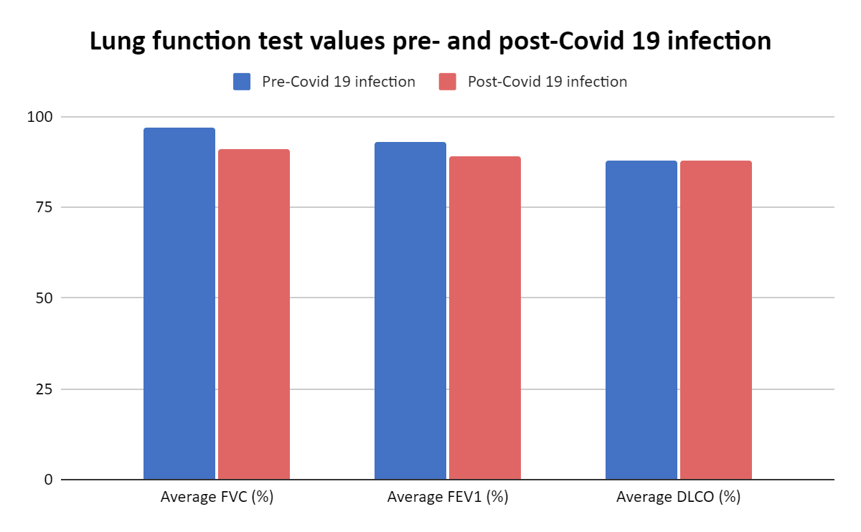
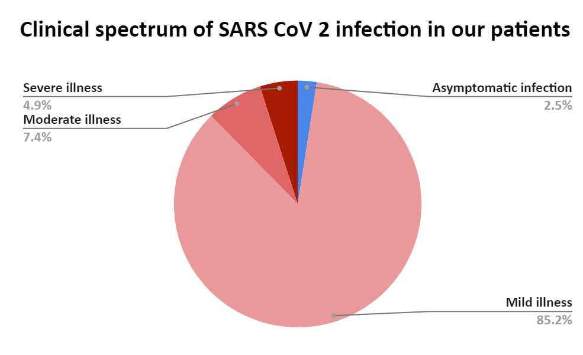
Covid 19 in patients with sarcoidosis: clinical course and outcome – single center experience
BATARILO HAĐAR M.¹, Janković Makek M.^{1,2}, Rnjak D.¹, Mihelčić Korte D.¹, Džubur F.^{1,2}, Glodić G.¹, Pevec M.¹, Krpina K, Moćan A.¹, Pelicarić D.¹, Samaržija M.^{1,2}, Čorak L.¹, Ljubičić L.¹, Hećimović A.^{1,2}
¹ University Hospital Center Zagreb, Clinic for Respiratory Diseases ² University of Zagreb, School of Medicine
AIMS:
RESULTS:
The average FVC before Covid 19 infection was 97% (72±131) and 91% (63±123) after, average FEV1 prior to infection was 93% (49±125) and 89% (43±123) after, and DLCO prior to infection was 88% (54±131) and 88% (56±133) after. In 3 patients with moderate and 4 patients with severe form of disease decline in lung function tests after infection was observed. 2 of them were not vaccinated, 4 was vaccinated after and 1 was vaccinated prior to infection. In other patients there was no significant decline in lung function tests after Covid 19.
Sarcoidosis is inflammatory, multiorgan disease with pulmonary involvement in more than 90% cases and often is treated with immunosuppressive therapy, which make patients more susceptible to infections. Knowing that patients with underlying chronic lung disease may have worse outcome of SARS CoV2 infection, our aim was to analyze if patients with sarcoidosis are at higher risk of severe forms of Covid 19 infection. We investigated how immunosuppressive therapy and vaccination status affected the clinical course and outcome.
A total of 81 patients were included (48 females, 33 males) with median age 52 years (30±77). 47 (58%) patients were without immunosuppressive therapy during Covid 19 infection, 24 (30%) were treated with prednisone and 10 (12%) were treated with prednisone and methotrexate. 2 (2%) patients had asymptomatic infection, 69 (86%) patients had mild form of disease, 6 (7%) had moderate disease, 4( 5%) had severe form of disease and none developed critical disease. The patients who developed severe forms of disease had underlying medical conditions that are classified as risk factors (cardiomyopathy, diabetes mellitus, arterial hypertension and obesity).
50 patients were vaccinated, 21 prior to Covid 19 and 29 after.
METHODS:
We retrospectively collected data on patients with sarcoidosis from our Clinic who were tested positive for SARS CoV-2 from Jan 2020 until April 2022. It included demographic data, severity of Covid 19 infection, immunosuppressive therapy during infection, lung function tests prior and after the infection and vaccination status.
CONCLUSION:
Our mostly developed mild form of Covid 19 infection patientsand immunosuppressive therapy had no impact on course of Covid 19. Decline in lung function tests was observed in patients with moderate and severe form of disease, who mostly weren´t vaccinated prior to infection.

