Slide 1
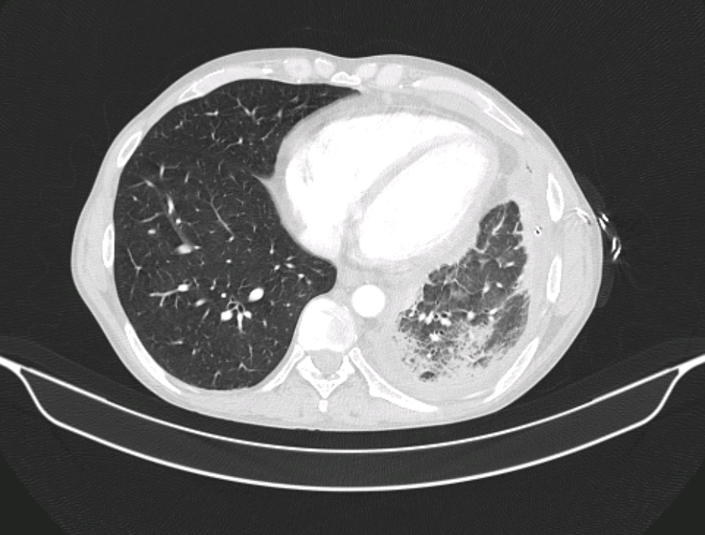
Case report of a patient with neutrophil-predominant tuberculous pleural effusion
ŠKORO M.¹, Badovinac S. ¹, Banić M.¹, Džubur F.¹, Kovačić H.¹, Moćan A.¹, Pavliša G.¹, Puretić H.¹, Samaržija M.¹, Žmak Lj. ², Janković Makek M.¹ ¹ Klinika za plućne bolesti Jordanovac, KBC Zagreb, ² Hrvatski zavod za javno zdravstvo
INTRODUCTION
Tuberculous pleural effusion (TPE) is the second most common form of extrapulmonary tuberculosis. In clinical practice, the diagnosis is generally made by the combination of biochemical and cytological pleural fluid analysis. Tuberculosis is typically characterized by lymphocyte-predominant exudate (lymphocyte to neutrophil ratio >75%) and by adenosine deaminase (ADA) values > 40 U/L. However, in 7% of the cases, TPE presents as neutrophil-predominant fluid, hence implying the parapneumonic effusion.
Bronchoalveolar lavage (BAL) samples were smear- and PCR-negative on Mycobacterium tuberculosis. Opportunistic pathogens, Lactobacillus spp., and R. mucilafinosa were isolated, and initial antibiotic therapy was continued. The additional examination confirmed liver cirrhosis with portal hypertension and ascites (likely due to alcohol) alongside with previously diagnosed chronic pancreatitis.
The course of hospitalization was complicated new-onset thrombocytopenia (min Trc 3x10⁹/L). Hematologic workup yielded a diagnosis of immunotrombocytopenia with a good response to steroid therapy. After one month of treatment, normalization of acute-phase reactants and incomplete regression of infiltrate, he was discharged while still awaiting the microbiological culture results. Finally, three weeks after discharge, BAL fluid culture confirmed tuberculosis and the patient was hospitalized for initiation of ATL therapy.
CASE REPORT
35-year-old S.M., with a history of recurrent alcohol-induced pancreatitis, was admitted due to prolonged dry cough, progressive exertional dyspnea, malaise, and weight loss over the course of two months. The initial imaging revealed a large left-sided pleural effusion, along with elevated inflammatory markers and high levels of liver function tests. Left hemithorax drainage and empiric antibiotic therapy (meropenem and vancomycin) were initiated. The pleural fluid analysis revealed neutrophil-predominated exudate (60% neutrophil, 33% lymphocyte), ADA level of 78 U/L, and sterile initial microbiological analysis. CT affirmed circumferential pleural thickening and parenchymal consolidation of the lower left lobe with cavities (Figure 1).
CONCLUSION
The diagnosis of TPE can be a challenge. Although lymphocyte-predominant exudate with high ADA level is considered characteristic for TBC infection, the diagnosis is not excluded by neutrophilic predominance on cytological analysis. Neutrophil-predominant TPE is associated with a more intense inflammatory response and higher positive rates in microbiological testing.
Choi H, Chon HR, Kim K, Kim S, Oh K-J, Jeong SH, et al. (2016) Clinical and Laboratory Differences between Lymphocyte- and Neutrophil-Predominant Pleural Tuberculosis. PLoS ONE 11(10): e0165428. doi:10.1371/journal.pone.0165428
Porcel, J. M., & Light, R. W. (2006). Diagnostic approach to pleural effusion in adults. American Family Physician, 73(7), 1211–1220.
Figure 1. CT scan showing left-sided circumferential pleural thickening alongside with parenchymal consolidation of the lower left lobe with cavities

