Slide 1
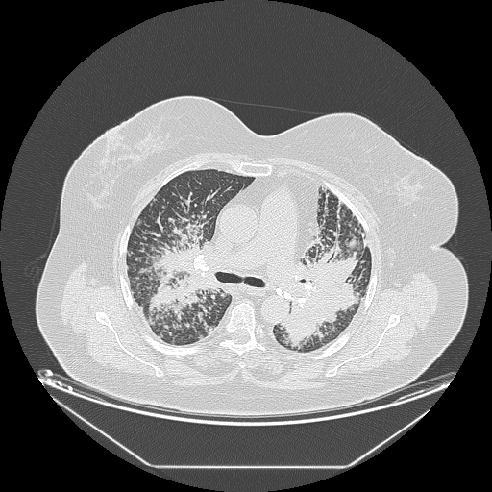
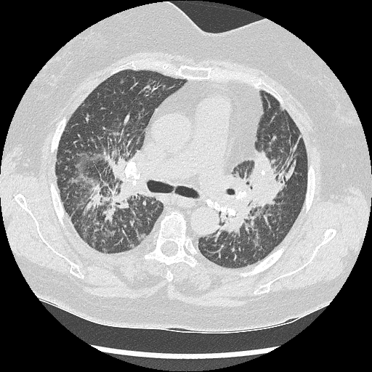
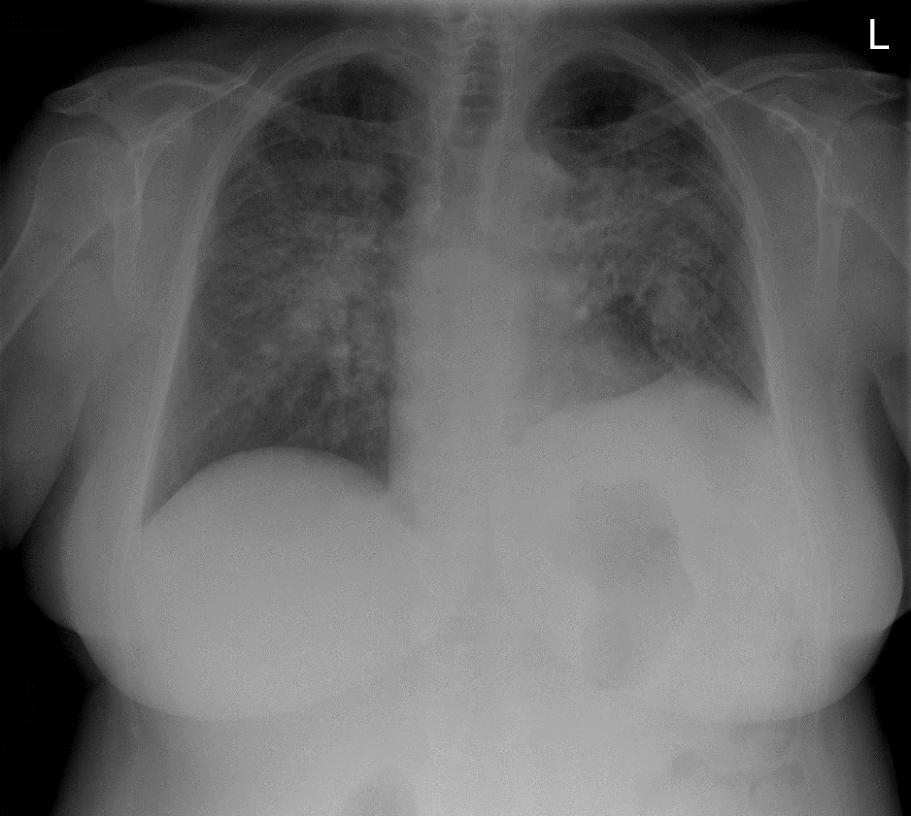
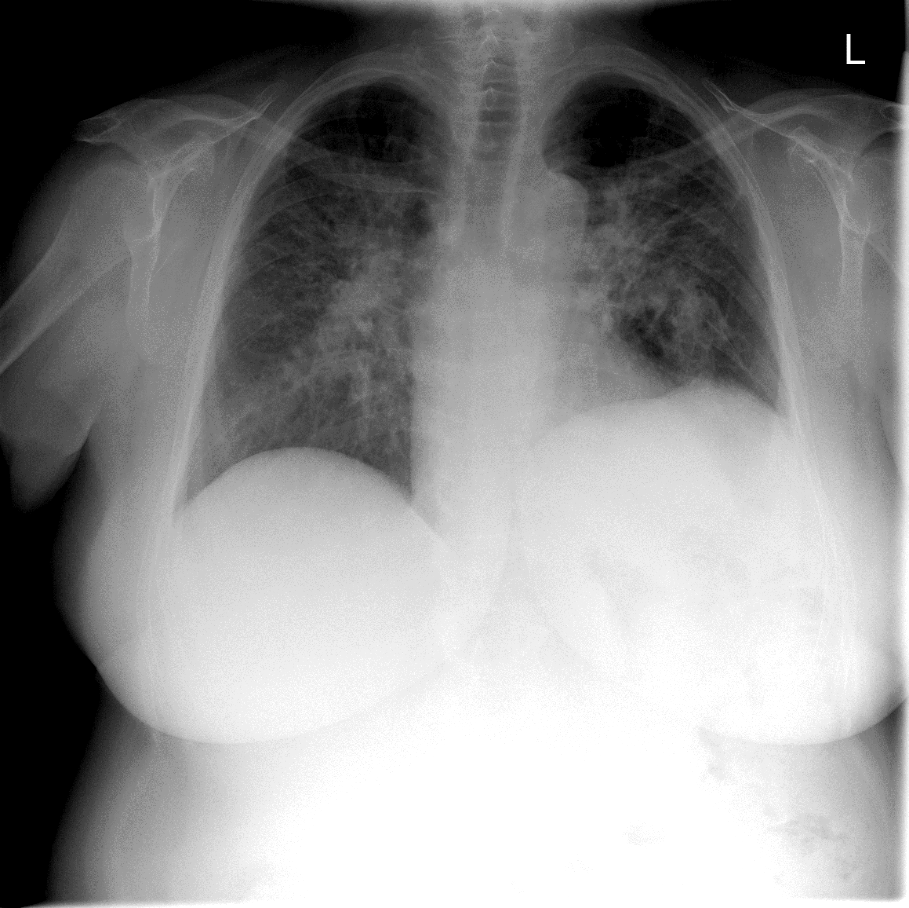
CHALLENGES IN THIRD LINE TREATMENT OF SARCOIDOSIS Čorak L., Džubur F., Janković Makek M., Krpina K., Lovrić T., Mihelčić Korte D., Moćan A., Pavliša G., Pevec M., Puretić H., Samaržija M., Žuljević E., Hećimović A.
INTRODUCTION: Sarcoidosis is a chronic, systemic disease, characterized by histology finding of noncaseating granulomas, that typically affects lungs and lymph nodes. Most of the cases resolves spontaneously or responds well to corticosteroids but in some cases disease is refractory to first and second line treatment.
CASE REPORT: A female patient was diagnosed with pulmonary sarcoidosis (stage three) in 2014 at the age of 61. At first she was treated with corticosteroids but due to the lack of response over the course of one year methotrexate was added as a second line drug.
Patient was on this dual treatment until May 2018 and while on therapy she was progressively worsening and in 2017 long term oxygen therapy was indicated because of chronic respiratory insufficiency. In May of 2018 CT scan revealed bilateral progression of interstitial lesions as well as consistent lymphadenopathy. In blood tests there were signs of liver damage but with abdominal ultrasound within normal limits. She was then treated with pulse doses of glucocorticoid therapy (prednisone, started with 100mg per day). In early 2019 she was admitted to our hospital because of deterioration in her respiratory function. At that point she had secondary polycythemia (Hgb 179 g/L) beside elevated liver enzymes. The CT scan showed substantial progression of parenchymal lung lesions, consolidation with air bronchogram and calcified lymph nodes. Liver biopsy was indicated to establish etiology of liver damage and it proved granulomatous inflammation. PET/CT scan showed multiple organ active sarcoidosis that among lungs and lymph nodes also involved liver, spleen and bones. Considering that and the absence of a response to previous treatments the third line immunomodulatory treatment was indicated, TNFα inhibitor infliximab which was added to corticosteroid and methotrexate. Treatment was started in September 2019 and first objective improvement was noted in January 2020 when a control CT scan was performed which showed regression of bilateral infiltrates. Concurrently patient’s dyspnea was reduced; she could endure more physical exertion and at times even oxygen needs were lessened.
Fig. 1. CT from 02/2019, while on glucocorticoid treatment
Fig. 2. CT from 01/2020, after four months of treatment with infliximab
Fig. 3. in August 2019; before treatment
Fig. 4.in October 2019; after one month of infliximab
CONCLUSION: While corticosteroids and second line immunosuppressant drugs are usually successful in treating sarcoidosis, there are some hardly manageable cases that need our special attention. There is no official third line treatment guidelines for sarcoidosis and infliximab is one of the most often used drugs based on several studies which showed efficacy. Infliximab can be efficient in suppressing symptoms, treating lesions, as well as in reducing needed corticosteroid dosages.^{1,2}
1. Jamilloux, Y. et al., 2017. Efficacy and safety of tumor necrosis factor antagonists in refractory sarcoidosis: A multicenter study of 132 patients. Seminars in Arthritis and Rheumatism, 47(2), pp.288-294.
2. Doty, J., Mazur, J. and Judson, M., 2005. Treatment of Sarcoidosis With Infliximab. Chest, 127(3), pp.1064-1071.

